Slide 1
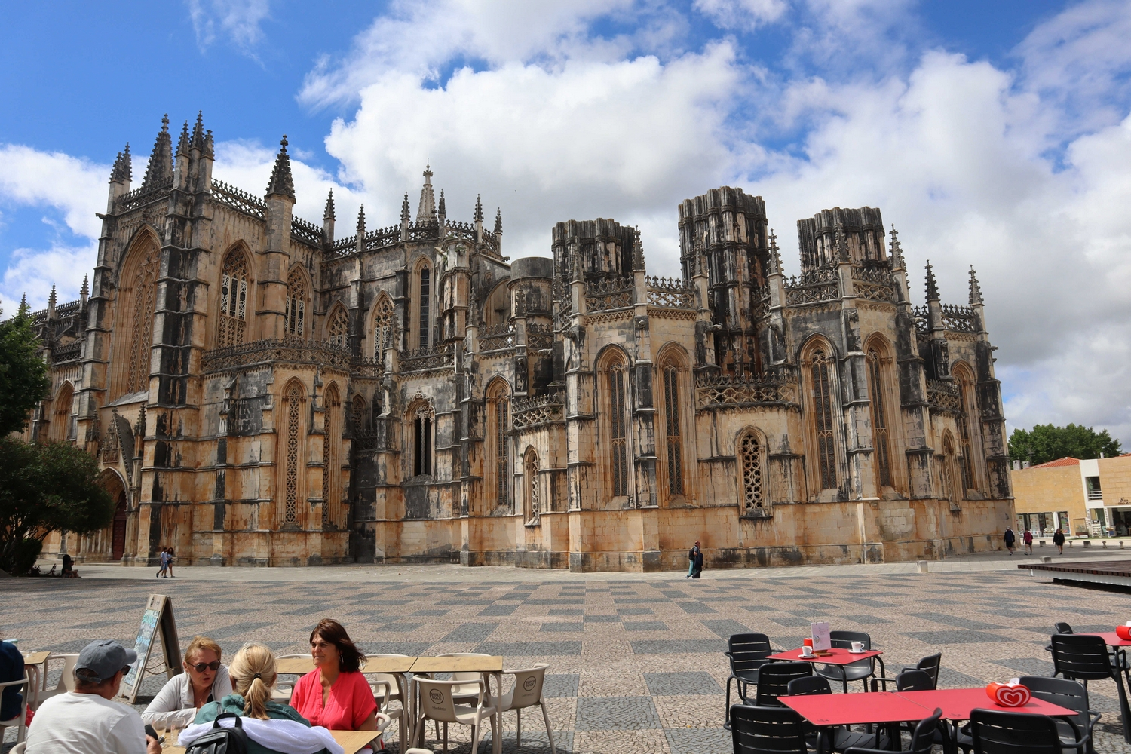
CLOSING CEREMONY
Batalha, June 22nd, 2023

Slide 2
It's time to say goodbye or see you soon... hope to see you at the next GSC, somewhere in the world.
The Global Congress 2023, the only international congress of Stone, has brought together over the last 5 days, companies, researchers, and all those who work in innovation, in Portugal, in the Center Zone, in Batalha.
It was 5 days of true sharing and knowledge. These were days when together we were able to discover what Natural Stone involves in Portugal, Quarries, Factories, Monuments, History, Culture and Art.
They were days of true networking, but above all where net friendship was created (I don't know if the term exists, but you get the idea).

Slide 3
To everyone who participated, who got involved, who sponsored and to the entire operational team, my thanks. Everyone was fantastic!!!
We celebrated Natural Stone and knowledge and I believe that we all evolved a little more.
It remains my/our commitment for the Global Stone Congress to continue traveling around the World promoting Natural Stone, sharing, knowledge and innovation.
See you soon...
Marta Peres
Executive Director of Mineral Resources Cluster
Global Stone International Committee Member

Slide 4
ASSIMAGRA – Portuguese Mineral Resources Industry Association – would like to thank all the participants, sponsors, speakers and organizers who made this 7th edition of the Global Stone Congress in the Central Region of Portugal a successful event.
Also, a special thanks to the Presidents of the Municipalities of Batalha and Porto de Mós, and to the directors of the Monastery of Batalha and Feira Stone Ibérica for hosting the activities of this congress.
It was with great pride that we hosted this congress in the central region of Portugal, where the extractive and natural stone processing industry is one of the most important economies present.

Slide 5
There were 5 days of intense work and, certainly, an opportunity to get to know the natural stone industry in this region, but also to promote collaboration between different professionals and entities from different geographies around the world, to share knowledge, trends and technological advancements and an opportunity to grow together.
Thanks again and we look forward to seeing you all again on the next global stone.
Célia Marques
Executive Vice President of ASSIMAGRA
Portuguese Association of the Mineral Resources Industry

Slide 6
University of Évora would like to thank all the participants, sponsors, speakers and organizers who made possible this 7th edition of the Global Stone Congress.
Personally, let me start by thanking you dear colleagues, dear participants, dear friends.
Without you we would not be here for sure!
You gave us what is more precious in life, your time to share, thank you!
Once a dear friend told me that landscape is nothing if there are no people to watch it… you are our landscape because, as you felt these days, our focus is on the people, besides the stone that gather all together, of course!
Even in the companies we visited you notice it.

Slide 7
People came before and after all processes…
Saying that, I would like to address my recognition to all that made this congress happen.
First, to our small but precious team: André, Catarina, Célia, Inês, Nelson, Susana, Sílvia, and of course Marta!
This group really worked as a team; everyone knew exactly what they had to do… just so you to know our meetings took no more than a few minutes, just to delivery tasks. It is a real pleasure to count on you, thank you!
Without our sponsors the Global Stone Congress would not have been possible!

Slide 8
I must highlight the first line sponsors:
Joaquim Ruivo from the Batalha Monastery; José Frazão from ExpoSalão and Rogério Henriques to StoneIbérica; Jorge Vala from the Municipality of Porto de Mós; Carlos Rabadão from the Leiria Polytechnic Institute; Ana Pagará from the Alcobaça Monastery; Raúl Castro from the Municipality of Batalha, and, Isabel Damasceno (Congress President), from the Commission for Coordination and Regional Development of the Center.
A special word is due to our friends and Diamond sponsors:
José Júlio from Julipedra; Samuel Delgado from Solancis; Filipe Miguel from Marfilpe, and, Eliseu Frazão from Fravizel.

Slide 9
Last but not least, I also want to thank our Platinum sponsors and all the Entities that supported us from the beginning without questioning. We deeply acknowledge your support.
I am very biased to say but I think after a full week that passed in a glimpse, we all have learned a lot of new things and we are now closer related. That was our purpose from the beginning!
Until we meet again, thank you very much!
Luís Lopes
Professor at the University of Évora, Global Stone International Committee Member
President of the Portuguese Association of Geologists (APG)

